Slide 1
Introduction to Unity Engine
S J Rajath Krishna
Sayan Guha
Shiva K Deviah

Slide 2
About Game Development
Video game development is the process of creating a video game. Development is undertaken by a game developer, which may range from one person to a large business. Traditional commercial PC and console are normally funded by a publisher and take several years to develop.
Various actors in Game Development:
Sound Artists
Narrators
Technical Art
Game developers or engineers

Slide 3

Unity 3D Engine
What is Unity?
Game engine – system designed to help create video games - easier and faster
Visual editor – see changes in real-time - Interactive and rapid prototyping
Component-based – functionality built out of smaller pieces - modular and extensible

Slide 4
What Unity looks like

Slide 5
Languages of Unity
C# (most common)
Javascript
Boo

Slide 6
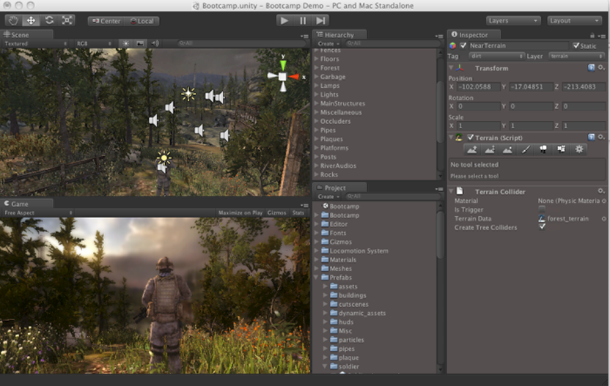





Concepts and Workflow

Slide 7
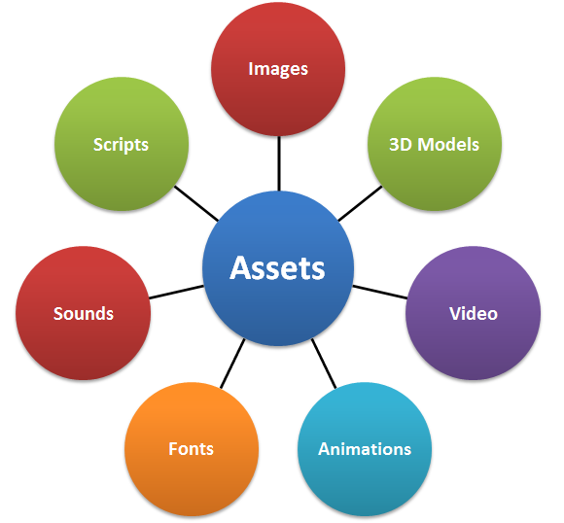
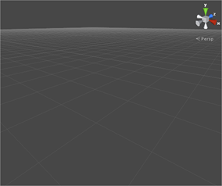
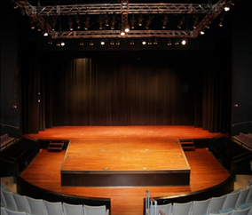
Assets
Scenes
Unity games are divided into scenes
Scenes are empty spaces that can be filled with game objects

Slide 8
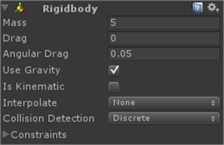
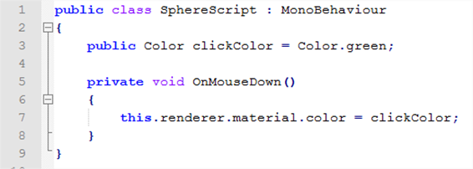
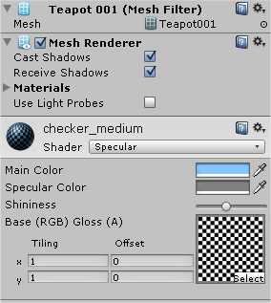
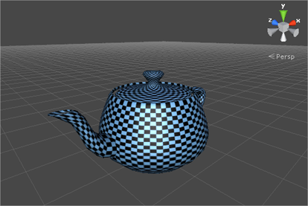
Game Objects
Components
Everything inside a scene is a game object
Initially, a game object has no functionality.
Each component adds a piece of functionality to the game object.
Types of components:
The Transform component (which, where, how)
The Physics component (rigidity and movability)
The Rendering component (what and how to draw)
The Script component (adds behaviour)
Prefabs (Store a game object together with is components + configurations for easy )
Other components: light, audio, particles, skybox, etc.

Slide 9
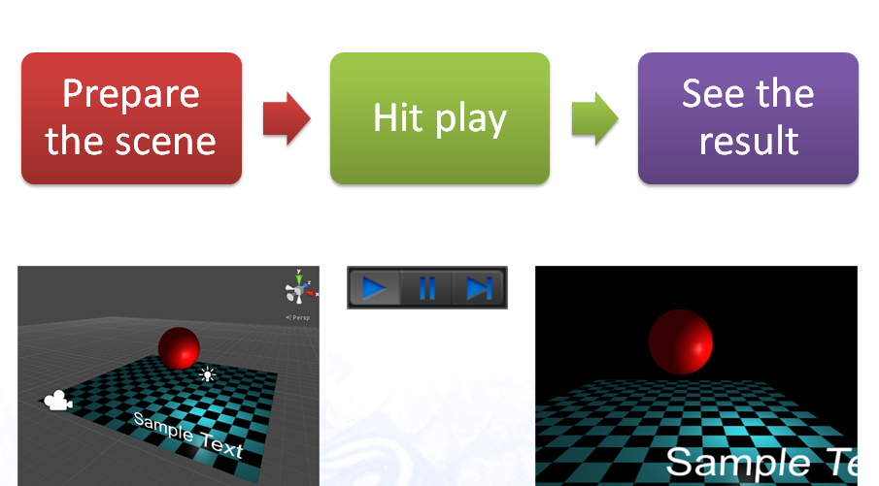
Game

Slide 10
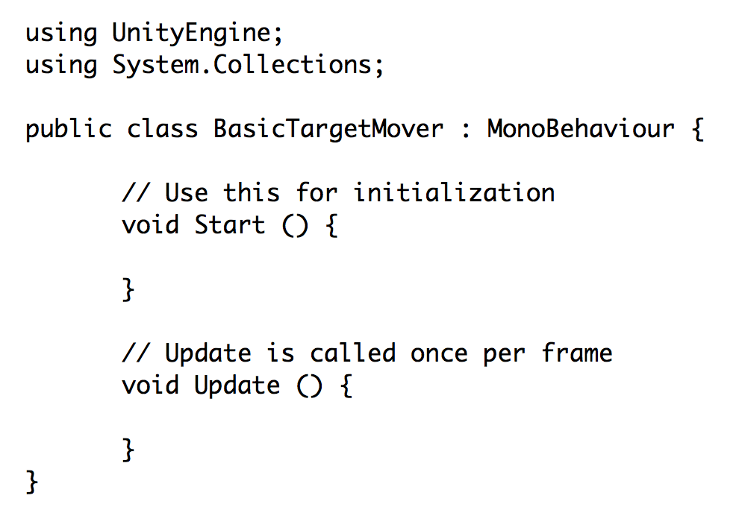
Unity Coding Standards
Typical Unity C# template
Important concepts
MonoBehavior is the base class that all Unity scripts are derived from
public variables are exposed in the editor
public variables and functions can be accessed when you have a reference to the component
you can make an Object global by creating a public static variable

Slide 11
Our Mini Project… ”Maze Runner” with Unity

Slide 12
Idea and Motivation
Idea: To create an adventure-based game where a player maneuvers through randomly generated mazes filled with traps, collecting coins and advancing levels.
Motivation: To learn more about Computer Graphics and Physics Engines. Physics engines are the most popular software for game development. We aim to learn how to use these engines and also implement ML/AI in real world applications.

Slide 13
Tools Needed
Unity 3D engine To build the actual game
MonoDevelop C# scripting editor to implement the game’s functionality
Autodesk Maya (not finalized) Rendering assets for the game

Slide 14
Artificial Intelligence with Perception
Objective In order to create a fun and challenging AI for any game, we need to rely on the “senses” of the respective AI in order to determine its logic.
For example, you may need to create an enemy AI character whose action is triggered when the player is in it's line of sight, i.e., when the enemy “sees” the player.

Slide 15
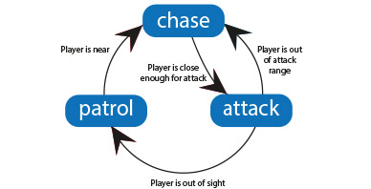
Proposed Implementation We develop an enemy AI script that models a finite state machine that consists of patrol, alert and chase states along with simple behavior for each of those states.
Finite State Machine

Slide 16
Algorithm
Initialize the values for static data like speed of movement, speed of rotation and span of patrol area.
Target player to be attacked.
If the player lies within a specific range (line of sight, Ray Casting in Unity) of the enemy's area of interest, then rotate the enemy to “look” at the player. Chase or follow the player till he collides or is out of sight, else continue patrolling.

Slide 17
Colliders and Raycasts
Colliders and Raycasts are often used to determine proximity and visibility respectively.
A collider will tell you with confidence whether a player is nearby.
A Raycast will give you the confidence about whether the enemy’s sight is not blocked.

Slide 18
Conditions for Player Sighting by Enemy
1. Player is within the enemy’s trigger zone (Achieved by looking for collisions of an enemy’s sphere collider)
We have implemented this by adding a sphere collider component for the enemy which is large enough to collide with the player whenever the player is nearby. We have considered a radius of about 3 times the enemy width.

Slide 19
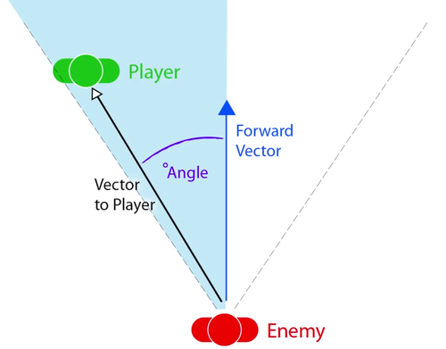
2. Player is in enemy’s field of view (Achieved by calculating the angle view between the player and the enemy)
We calculate the following to implement this.
A vector from enemy to player – calculated as (other.transform.position - transform.position)
A forward vector projected from the enemy - calculated as transform.forward

Slide 20
3. Enemy’s view is not blocked (Achieved by projecting a raycast from the enemy and checking if it collides with the player)
We again establish a raycast from the enemy in the forward direction, with the same radius as the collider.
If the raycast collides with the player, then we know that the player is visible to the enemy, and all conditions have been met.

Slide 21
Mazes
Why the need for a maze? The player begins each new level in a randomly generated maze. The player must navigate through the maze until they find the exit that leads to the next level. We will use AI to strategically place powerups as well as enemies in such a way that it is not too hard or too easy to beat the game.

Slide 22
Maze Generation Algorithm
The simplest way to generate a maze is start with a box grid and then use depth-first search with recursive backtracking to forge paths.
Algorithm generateMaze(m, n):
Generate a grid G of dimension m x n
Start with the top-left square on G, mark it as visited
while there are still unvisited squares do
if the current cell has unvisited neighbours:
choose a random square next
break the wall between current and next
push current onto the stack
set current ← next and mark it visited
else
pop a square prev from the stack
set current ← prev
Finally, break the wall for the top-left and bottom-right squares to complete the maze

Slide 23
Maze Implementation
A simple recursive DFS algorithm has been implemented using C#. As a next step we will be rendering it on the UI.
DEMO

